Slide 1
Chapter 18
Discriminant Analysis

Slide 2
Research Situation
In Discriminant Analysis, the outcome or dependent variable is categorical/ group membership.
The X_{i} predictor variables are usually quantitative.
The goal of the analysis is to use scores on k intercorrelated X predictor variables to predict group membership for each individual case.
Notes:
Note that Logistic Regression is another way to handle this type of data. Chapter 21 provides a brief introduction to Binary Logistic Regression, in which the outcome variable has only two groups or categories.

Slide 3
Abbreviations and Definitions
MR Multiple Regression
Y = actual score on Y outcome variable;
Y’ = predicted Y score based on X scores for k
predictor variables
z’_{Y} = predicted z_{Y} score based on z_{X} scores
DA Discriminant Analysis
D = score on a Discriminant Function
created from a weighted sum of z_{X} scores
for p predictor variables

Slide 4

Goal in DA: Create one or more new variable(s) such as D₁ (D₁ is called a “discriminant function score”) We want scores for D₁ that have the highest possible SS_{between}, the lowest possible SS_{within}, and the maximum possible F for the outcome categorical variable. In the equation below for discriminant function score D₁, the coefficients d₁₁, d₁₂ etc. are comparable to β coefficients in MR.

Slide 5
How DA is similar to MR:
In both DA and MR, we obtain equation(s) that use weighted combinations of raw scores or z scores on X predictor variables to generate predictions about outcomes on the dependent variable for each case.

Slide 6
How DA differs from MR
The goal in MR is to generate predicted Y’ scores that are as close as possible to actual Y scores.
The goal in DA is to generate scores on one or more discriminant function(s) that have means that are as far apart as possible for the groups designated by scores on the outcome variable; the actual values of the scores on the discriminant function do not matter, only the pattern of these scores across groups.
(Because units for D are arbitrary, D discriminant function scores are usually scaled like z scores with mean near 0 and variance close to 1).

Slide 7
How DA differs from MR
MR generates one predictive equation for Y’.
The number of discriminant functions created in DA depends on the number of groups, k, and the number of predictor variables, p.
Assuming that the p predictors are not perfectly linearly predictable from each other, the number of discriminant functions obtained in a research situation is the minimum of these two values:
(k-1) and p.

Slide 8
Differences between MR and DA
Computation of coefficients for
Goodness of predictions in DA can be assessed in several ways.

Slide 9
Differences between MR and DA
Overall significance of MR is usually tested using an F ratio based on MS_{regression}/ MS_{residual}; goodness of fit is assessed by looking at R and R².
Goodness of prediction in DA can be assessed in several ways; DA provides information separately for each discriminant function and for the overall model. New statistics are introduced: the eigenvalue λ and canonical correlation r_{c} for each discriminant function; and Wilks Λ for sets of discriminant functions. In addition we can examine the percentage of cases correctly classified into each group.

Slide 10
Reasons to do DA:
Develop a model that does a good job of predicting group membership for individuals (this may be particularly valuable in applied situations such as medical diagnosis, college admissions).
Describe the nature of differences among groups by noting which combinations of variables differ most between various groups in the study. This may be of greater interest in theory driven research.

Slide 11
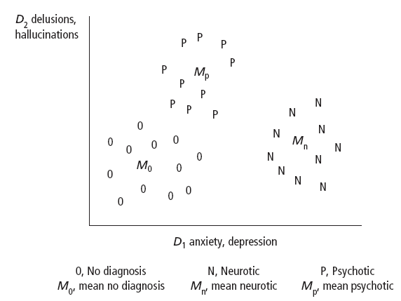
Hypothetical data for three groups
D₁: large weights for anxiety, depression; D₂, large weights for delusions, hallucinations. Discuss: How does group N (Neurotics) differ from group 0 (no diagnosis)? How does group P (Psychotics) differ from the other two groups? What pattern of scores would lead you to predict that a patient is a member of the Psychotic group?

Slide 12
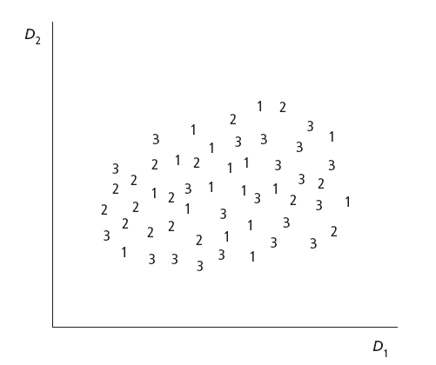
Distribution of scores on D₁ and D₂ provides no clear discrimination among three groups in this situation
How does the spatial distribution of scores for groups 1, 2, 3 in this plot differ from the scores for groups 0, N and P in the previous slide?

Slide 13
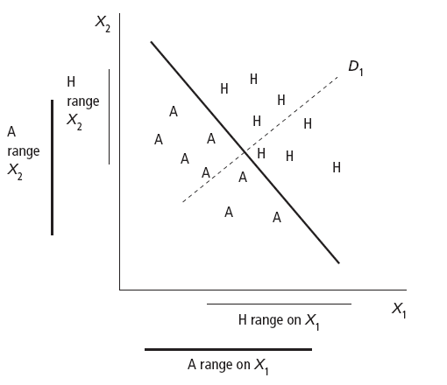
Discuss: Do groups A and H differ much in their range of X₁ scores? Do the groups differ much in their range of X₂ scores? Can we differentiate members of these groups when we look at their combination of scores on X₁ and X₂?

Slide 14
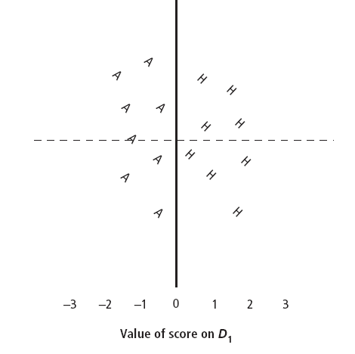
Rotated version of previous plot, showing scores on D₁ as the X axis (dotted line) and the “decision rule” for group membership as D₁ = 0 (vertical solid line)

Slide 15
Why do a multivariate analysis?
Given a group membership/categorical variable, and scores on several X quantitative variables, we could provide some partial description of the pattern in the data by just doing a one way ANOVA separately for each X quantitative variable across groups. Why is a multivariate (DA) approach potentially better than a series of one way ANOVAs?

Slide 16
Comparison of DA to a set of univariate ANOVAs
DA provides one “omnibus” significance test; univariate ANOVA provides p F ratios; reporting multiple significance tests may lead to inflated risk of Type I error.
As shown in the ape/human skull example: it is sometimes possible to discriminate between groups using a combination of scores on X variables, even when none of the X variables examined alone show clear differences across groups.

Slide 17
Comparison of DA to a set of univariate ANOVAs
3. DA may provide better statistical power for detection of group differences than a set of univariate ANOVAs (but not always).
4. Finally, when DA assesses between group differences in X scores, it statistically controls for correlations among the X variables (this is not taken into account in the univariate ANOVAs).

Slide 18
Research Questions in DA
For the entire set of all k groups, all p predictor variables, and all discriminant functions: does the DA predict group membership significantly?
The summary statistic that provides information this is Wilks’s Λ.
Statistical significance of Wilks’s Λ can be assessed by converting it to an (often approximate) F or χ².

Slide 19
Research questions in DA, continued:
2. How many of the discriminant functions obtained in the analysis provide useful information about differences among groups?
SPSS provides significance tests for sets of discriminant functions that can be used to decide how many discriminant functions provide useful information (“dimension reduction analysis”)
It may be possible, in some situations, to interpret discriminant functions as “dimensions” along which groups differ.

Slide 20
Example: suppose there are k = 5 groups, p = 7 discriminating variables, and four discriminant functions: D₁, D₂, D₃, D₄
Discriminant functions are “rank ordered” in terms of predictive strength; that is, D₁ is more highly predictive of group membership than D₂, D₂ more predictive than D₃, etc.
SPSS provides significance tests for the following sets of functions:

Slide 21
Example of Tests for Sets of Discriminant Functions
Set 1: D₁, D₂, D₃, D₄ p = .032
Set 2: D₂, D₃, D₄ p = .048
(all except first)
Set 3: D₃, D₄ p = .17
Set 4: D₄ p = .83
In this example, because set 4 and set 3 are not significant (α = .05), only the first two discriminant functions would be interpreted.

Slide 22
Research Questions for DA continued:
3. What is the contribution of each X predictor variable? Which X predictors were useful in predicting group membership?
In order for an X predictor to be considered useful as part of the DA, it needs to have a “large*” weight in the equation for one of the discriminant functions that was retained for interpretation (and/or a high correlation with one of the retained discriminant functions).
(*No significance tests for individual predictors are provided within the DA, therefore, as in factor analysis, some arbitrary criterion is used to decide which coefficients or weights are “large”).

Slide 23
Research Questions for DA, continued:
4. Which group(s) can be well differentiated? It is possible for an overall DA to be “statistically significant”, and yet (as in a one way ANOVA) there may be some groups that do not have significantly different discriminant function scores. Post hoc comparisons among groups may be performed to evaluate which groups differ significantly, on which discriminant functions and/or combinations of X variables.

Slide 24
Research Questions for DA, continued
5. What meaning (if any) can be given to discriminant functions?
If all of the variables that have large weights in the computation of a function and/or high correlations with scores on the function measure the same thing or have something in common, it may be possible to “name” the function. For example, if scores on D₁ are highly related to verbal SAT, vocabulary, and writing skills, then D1 might be a “verbal ability” dimension.

Slide 25
Research Questions in DA, continued:
6. Finally, if the researcher is interested in classification of individual cases, it may be useful to notice which types of classification errors are most common and/or what characteristics are associated with being misclassified.

Slide 26
Issues in designing DA study
What groups are included?
What are the ns for each group, and are minimum group sizes sufficient? (If not, may need to drop or combine some groups).
Are the groups “discriminable”?

Slide 27
Issues in Designing DA
What Discriminating variables are included?
For theoretical studies, do these reflect the underlying constructs of interest?
For applied studies in which the development of classification procedures is of greater interest than theory testing, are the measures reasonably cost effective?
In both cases, are measures reliable? Do scores meet assumptions (e.g. normally distributed, all pairs of X variables linearly related)

Slide 28
Empirical Example (using subset of Project Talent data for high school seniors)
Outcome variable:
Cargroup: future career plans?
1 = Business
2 = Medicine
3 = Teaching
(Information about Gender is also included in this data set but not used until MANOVA is introduced in the next chapter)

Slide 29
Quantitative X predictors are test scores on the following:
English
Reading
Mechanical Reasoning (Mechanic)
Abstract (Reasoning)
Math
Office (Skills)

Slide 30
What computations are involved in DA?
Recall that for most analyses so far, we have needed to include SS and SCP terms.
SS = Sum of Squared deviations from a mean for an X variable
SCP = Sum of Cross Products of deviations of X and Y from their means

Slide 31
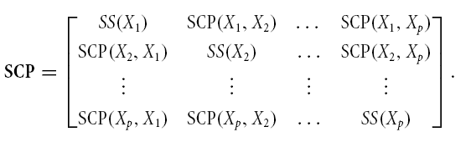
DA includes a set of p discriminating (X) variables. We need SS for each X variable and SCP for all p possible pairs of these X variables. SCP in bold represents the matrix that includes this entire set of terms.
Notes:
SCP is the sum of cross products.

Slide 32
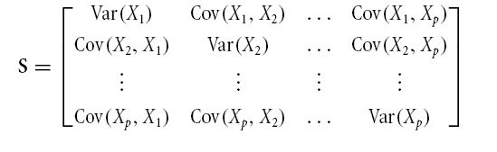
Note that if we divide each element of an SCP matrix by df or N, we obtain the corresponding variances and covariances.

Slide 33
SCP_{total} for the entire data set:
When we compute SCP_{total}, we calculate the SS for each X variable and the SCP for each pair of X variables, for the entire dataset, ignoring group membership.

Slide 34
We can also divide the data set into groups; in the empirical example in this chapter, we have three future career groups.
Within each group we compute the same matrix of SS and SCP terms for the X’s.
We will denote the within group SCP matrice for groups 1, 2 and 3 as
SCP₁, SCP₂, SCP₃

Slide 35
To find the overall SS within groups for the set of variables we just add these matrices (equal ns in groups assumed here; if ns are unequal, need to weight by sample size)
SCP_{within} = SCP₁ + SCP₂ + SCP₃

Slide 36

Note that to combine the SCPs across groups, we need to assume the corresponding population variance/covariance matrices (each denoted Σ) are equal:
This is analogous to the assumption of equal population variances H₀: σ²₁ = σ²₂ = … = σ²_{k} that should be met in one way ANOVA prior to computation of a pooled SS_{within} term.

Slide 37
Similar to ANOVA, DA involves partition of total SCP into within and between group SCPs*
SCP_{total} = SCP_{between} + SCP_{within} (1)
Note that equation (1) above is analogous to the partition of SS in a one way ANOVA (in equation 2 below), except that each term in equation 1 represents a set of SS and SCP terms for the group of p X variables.
SS_{total} = SS_{between} + SS_{within} (2)
*computational details omitted; see Tabachnick & Fidell (2007).

Slide 38
In equation 1 on preceding slide:
To create an overall test whether between group differences are large relative to within group variability, we need a way to summarize information about between/within group variability in an entire SCP matrix.
How can we obtain a summary value for an SCP matrix?

Slide 39
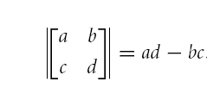
Determinant of a matrix provides a single number “summary*”
For a 2 x 2 matrix, the determinant is calculated as follows (computation is more complex for larger matrices)
*Determinant and other matrix operations and matrix notation were introduced in the Appendix to Chapter 14.

Slide 40
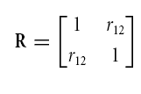
What is the determinant of R, a correlation matrix for X₁ and X₂?
|R| = (1*1) – (r₁₂*r₁₂) = 1 – r²₁₂
In other words: determinant of R tells us how much non-shared or non-redundant variance we have for the set of variables included in the matrix. More generally, determinant of an R or SCP matrix provides summary information about variance, with shared variance among variables subtracted out.

Slide 41
Application of Determinant to SCP matrices in DA
To summarize information about within group variability for the X’s (while controlling for or subtracting out redundant information), we take the determinant of SCP_{within}.
To summarize information about total variability for the X’s, we take the determinant of SCP_{total}.
Notation: |A| = determinant of A.

Slide 42
We are now able to set up a summary test statistic, Wilks Λ:
Λ = |SCP_{within}|/ |SCP_{total}|
Note that Λ differs from the summary F ratio statistic in one way ANOVA. F is obtained as MS_{between}/MS_{within}, thus, F is a ratio of explained to error variance, and a larger F indicates greater differences between groups.
By contrast, Λ is a ratio of error to total variance; and a larger value of Λ indicates smaller between group differences.

Slide 43
When we compute Λ for a univariate one way ANOVA:
When there is only one quantitative X variable that differs across groups, Λ reduces to:
Λ = SS_{between}/ SS_{total}
Thus, Λ = 1 – η² (and η² = 1 –Λ)
Recall that η² is an effect size for ANOVA; η² = SS_{between}/SS_{total} = proportion of variance in scores on quantitative variable that is associated with group membership or differs between groups.

Slide 44
Two places where Λ appears in DA
SPSS DA reports Λ for the overall model (including all groups/ all variables/ all discriminant functions). This can be reported as an overall effect size.
SPSS DA also reports values of Λ for sets of discriminant functions, and these can be used to decide whether some discriminant functions do not contribute significantly to discrimination among groups and should not be interpreted.

Slide 45
Statistical Significance of Λ
Note that Λ is a multivariate test statistic that has three different df terms; these, in turn, are based on the values of k (number of groups), p (number of quantitative predictor variables) and N (total number of cases). For convenience, most programs convert Λ to an exact (or approximate) F or χ² statistic, and use critical values of F or χ² to test statistical significance.

Slide 46
DA Statistics Associated with Each Discriminant Function
For each discriminant function, an eigenvalue λ is reported.
= SS_{between}/SS_{within} for a one way ANOVA of scores on this discriminant function across groups.
Thus, the larger the value of λ, the greater the between groups differences in scores on the corresponding discriminant function

Slide 47
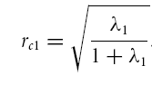
λ can be converted to a more convenient effect size:
r_{c1} is “the canonical correlation of scores on Discriminant function 1 with group membership”; it is equivalent to an h coefficient in a one way ANOVA. To obtain r_{ci} for discriminant function i, use the eigenvalue λ_{i} for discriminant function i; the equation for the first function appears above.
To obtain an estimate of the proportion of variance in scores on discriminant function i that is due to between group differences, square the canonical correlation for that function.

Slide 48
Role of λ in computation of DA coefficients
In computation of weights or coefficients for the first discriminant function, the goal of the computation is to obtain the maximum possible value of λ for scores on D₁.
For subsequent functions, the goal is to obtain the maximum possible value of λ for scores on that function, subject to the requirement that scores on each additional discriminant function must not be correlated with scores on earlier discriminant functions.

Slide 49
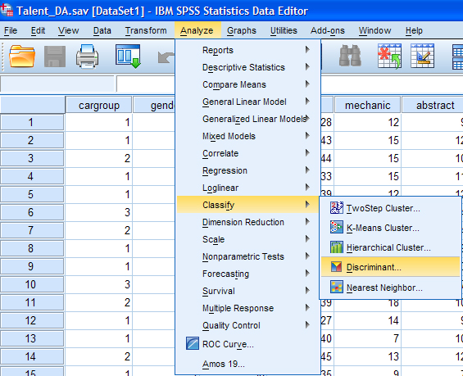
Menu selections for SPSS DA: <Classify> → <Discriminant>

Slide 50
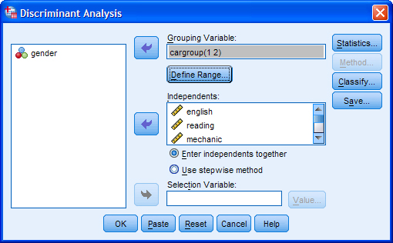
DA: Main dialog window

Slide 51
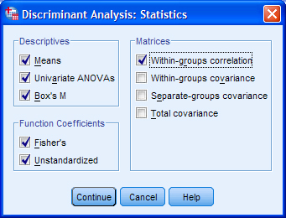
Statistics dialog window for DA

Slide 52
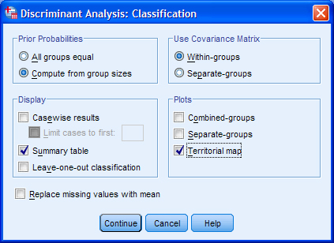
Classification dialog for DA

Slide 53
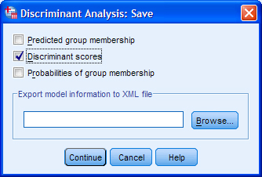
Command to save computed discriminant scores from DA

Slide 54
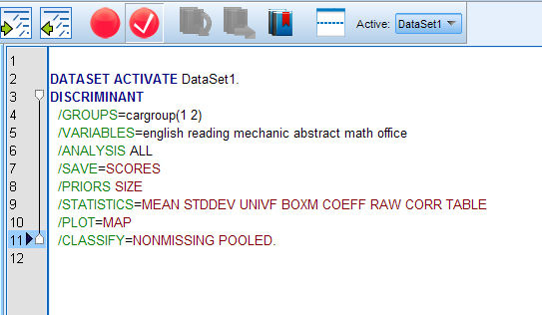
SPSS Syntax for DA example

Slide 55
Selected DA Output: Univariate Means

Slide 56
Univariate ANOVAs from DA (note that here, each X variable is assessed while not controlling for correlations with any other Xs)

Slide 57
Pooled within groups correlations among X variables in DA
As in MR, this information helps us recognize whether there is a high degree of intercorrelation among the X variables.

Slide 58
Test of Assumption of Equality of Variance/Covariance Matrices
Because the df are so high, this test may be extremely sensitive to violations of this assumption. A relatively large α (such as α = .10) can be used to make this test less sensitive. If we set α = .10, we would decide in this example that the assumption does not appear to be violated.

Slide 59
DA output, continued: Summary of information about individual discriminant functions

Slide 60
Test of entire model (functions 1 and 2 combined), p < .001 Test of function 2 alone, p = .949

Slide 61
Coefficients for the standardized discriminant functions (applied to z scores on the Xs)
D₁ = .420z_{English} + .015z_{Reading} +.443z_{Mechanic} + … +.748z_{Office}

Slide 62
Correlation of each X variable with scores on D₁ and D₂ (D₁ scores were constructed using the coefficients shown on previous slide)
Note that * indicates only that a coefficient is larger for D₁ than for D₂
(or vice versa); it does not indicate statistical significance. The “meaning” of a discriminant function may be inferred by examining the variables that have the highest correlations, and/ or the largest discriminant function coefficients.

Slide 63
Discriminant function coefficients (applied to raw X scores)
These coefficients may be useful for group classification.

Slide 64
Fisher classification coefficients
Note there is one score for each of the k groups; when classification into groups is of primary interest these functions may be easier to use than the discriminant functions.

Slide 65
The “centroid” for a group corresponds to the list of means for that group on all of the discriminant functions.

Slide 66
Prior probabilities for classification
Because the radio button for “Priors = size” was selected, the DA tried to classify about 60% of the cases into Business, 16% into Medicine, and 24% into Teaching (these correspond to the proportions of cases in the three groups or relative group sizes). If this selection had not been made, DA would have assumed equal probability for group membership and tried to classify about 33% of cases into each of the 3 groups.

Slide 67
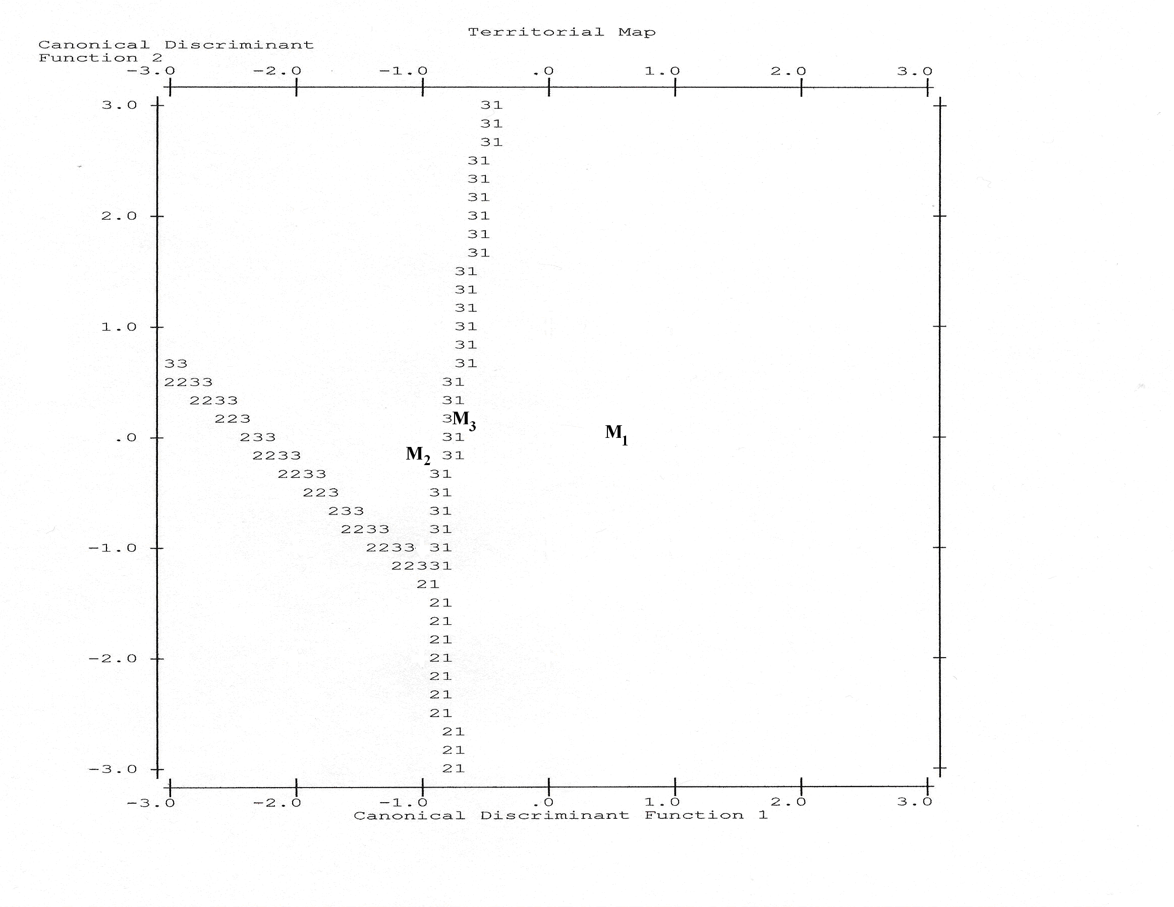
Territorial Map D₁ on X and D₂ on Y axis
SPSS only marks each centroid with an asterisk; M1, M2 and M3 markers for centroids of groups 1, 2 and 3 were added.

Slide 68
Actual Versus Predicted Group Membership

Slide 69
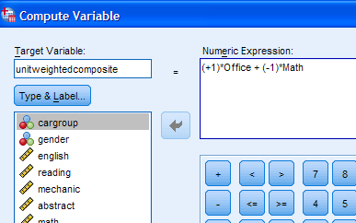
Creation of a unit weighted composite from the two variables given most weight in D₁

Slide 70
One way ANOVAs Top: “optimal” discriminant function D₁ Bottom: unit weighted composite (office – math)
Note: if you compute η² for the first ANOVA, you will find that it is close to the η² that you obtain from the previous DA (because virtually all of the group differences that could be predicted were associated with scores on D₁.
If you compute η² for the second ANOVA you can see that group membership is predicted less well by the unit weighted composite of raw scores on office and math, than by the optimally weighted D₁.

Slide 71
